Slide 1
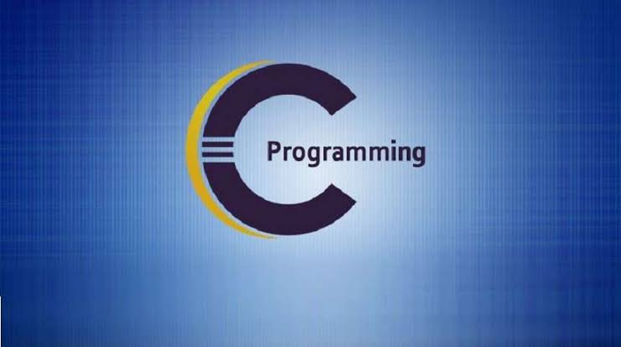

THE ORIGINS AND EVOLUTION OF C PROGRAMMING
Presentation by
Shawon & Siam
1

Slide 2
Table Of Content
Our Team
Traditional C
What is C?
K&R C
Why C?
Evolutions at a glance
Evolution of of C
2

Slide 3


Our Team
Shawon Gazi
Md. Siam Howlader
241400031
241400032
3

Slide 4
What is C.?
C is a high-level and general purpose programming language that is ideal for developing firmware or portable applications.
C is what is called a compiled language.
4

Slide 5

Why C?
Foundation for many other languages (C++, Java, Python, etc.)
Used in system programming, embedded systems, and more
5

Slide 6

Evolution of of C
  ALGOL
The root of all modern languages is ALGOL Introduced in the early 1960s.
ALGOL was the first computer language to use a block structure.
ALGOL gave the concept of structured programming to the computer science.
Peter Naur
6

Slide 7

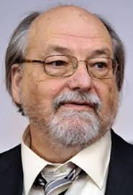
Evolution of of C
  BCPL
In 1967, Martin Richards developed a language called (Basic Combined Programming Language).
In 1970, Ken Thompson created a language using many features of BCPL and called it simply B.
Both BCPL and B were "typeless" system programming languages.
Martin Richards
Ken Thompson
7

Slide 8
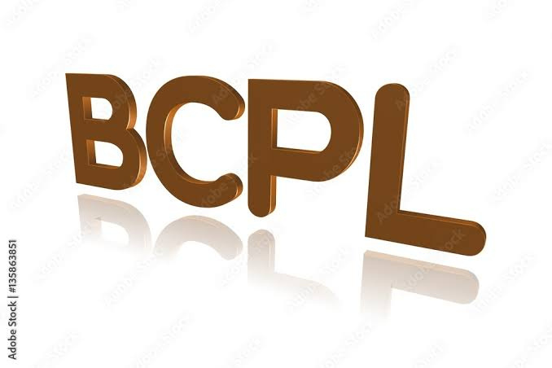
Evolution of of C
  BCPL
In 1972 C was evolved from ALGOL, BCPL and B by Dennis Ritchie at the Bell Laboratories.
Cuses many concepts from theses languages and added the concept of data types and other powerful features.
It is strongly associated with UNIX.
UNIX is one of the most popular network operating systems in use today.
8

Slide 9
Traditional C
During 1970s C had evolved into what is now known as "traditional C".
The language became more popular after publication of the book 'The C programming language' by Brian Kerningham and Dennis Ritchie in 1978.
For many years, C was used mainly in academic environments.
Today, C is running under a variety of operating system and hardware platforms.
9

Slide 10


K&R C
Brian Kerningham
Dennis Ritchie
The Book was so popular that the language came to be known as "K&R C" among the programming community.
10

Slide 11

Evolution of of C
  ANSI C
• In 1983 American National Standards Institute (ANSI) appointed a technical committee to define a standard for C.
• In December 1989 the committee approved a version of C which is known as ANSI C.
• It was then approved by the International Standards Organization (ISO) in 1990.
• This version of C is also referred to as C89.
11

Slide 12

Evolution of of C
  ANSI/ISO C
During 1990s, C++, a language entirely based on C, underwent a number of improvements and became an ANSI/ISO approved language in November 1977.
C++ added several new features to C to make it only a true object- oriented language but also a more versatile language.
During the same period, Sun Microsystems of USA created a new language java modelled on C and C++.
12

Slide 13
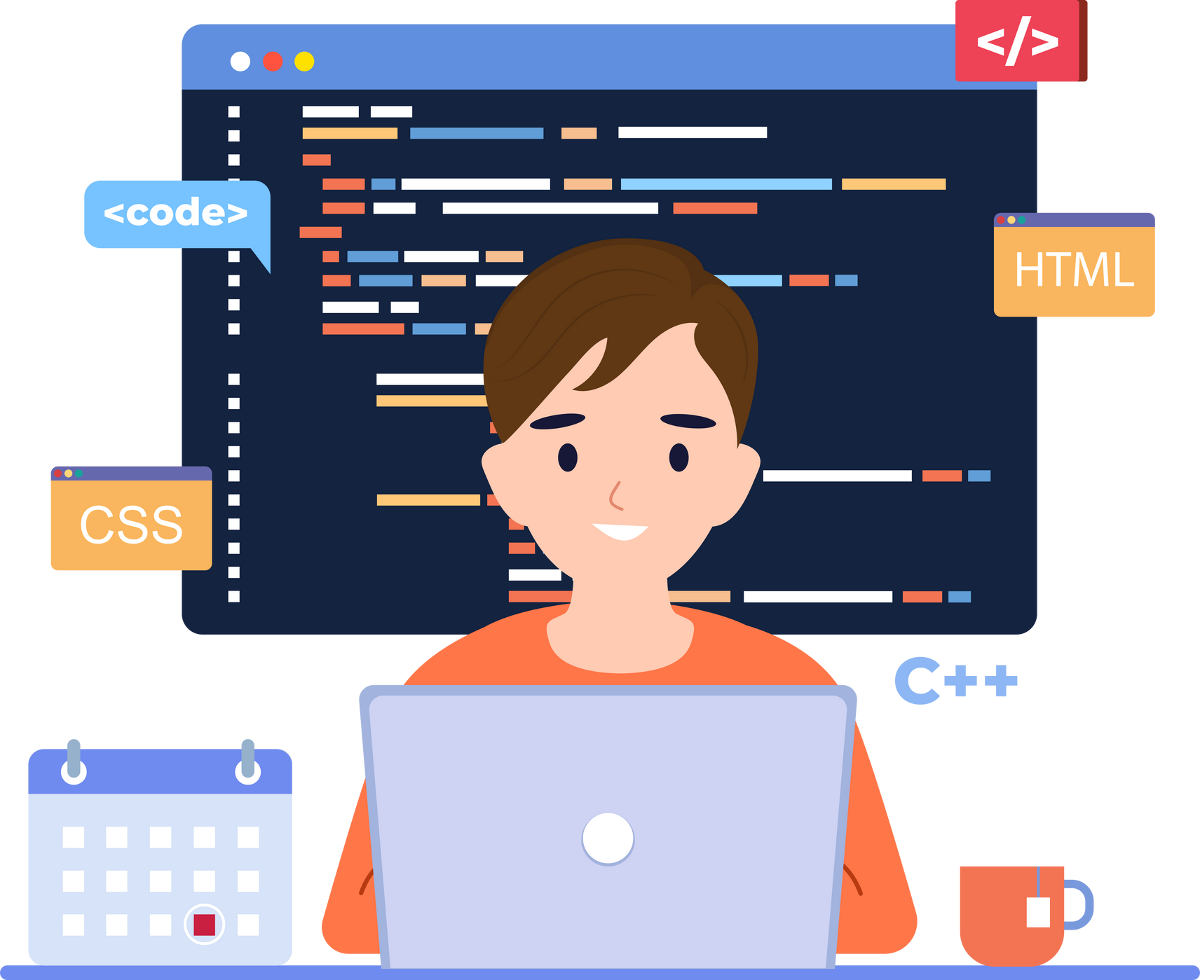
Evolution of of C
  C99
C99 (previously known as C9X) is an informal name for ISO/IEC 9899: 1999.
It extends the previous version (C90) with new features for the language and the standard library.
C99 is, for the most part, backward compatible with C89, but it is stricter in some ways.
13

Slide 14

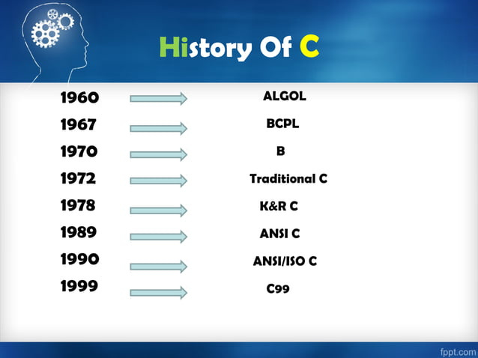
Evolutions at a glance
14

Slide 15



15
QUESTION SESSION
If you have any questions, feel free to ask now...

